Slide 1






Team 7
SC2001 : Lab 1 Hybrid Sort
Presented by
  Raj Yash
  Ramachandran Saichandar
  Rane Shruti Devendra

Slide 2
Team 7
Why Hybridize Merge Sort?
Merge Sort
  Divide the array into two halves
  Recursively sort both halves
  Merge the sorted halves
  Time complexity: Θ(n log n)
  Efficient and predictable for large datasets
  Weakness: recursion + merging small subarrays adds overhead
Insertion Sort
  Build a sorted portion one element at a time
  Insert each new element into its correct position
  Time complexity: Θ(n²)
  Simple control flow with low overhead
  Strength: efficient for small subarrays
Hybrid idea
Merge Sort for large subarrays → Insertion Sort for small subarrays

Slide 3
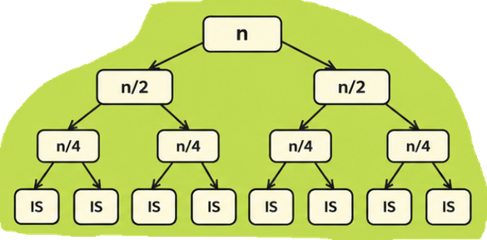
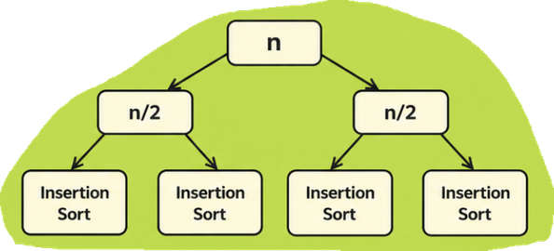
Team 7
Threshold S: What it does
Hybrid rule
If subarray size > S → continue Merge Sort | If subarray size ≤ S → switch to Insertion Sort
Effect of small S
Effect of large S
  More recursive
levels
  More merge
operations
  Smaller insertion sort leaves
  Fewer recursive levels
  Larger insertion
sort leaves
  More insertion-sort comparisons
S controls the trade-off between merge recursion depth and insertion sort leaf size

Slide 4
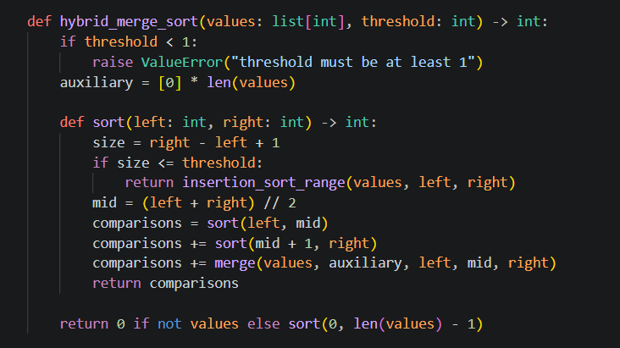

Team 7
Hybrid Algorithm Code

Slide 5
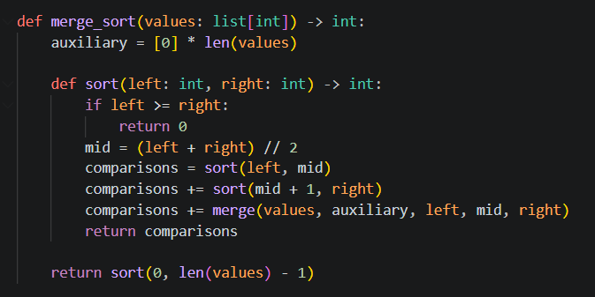
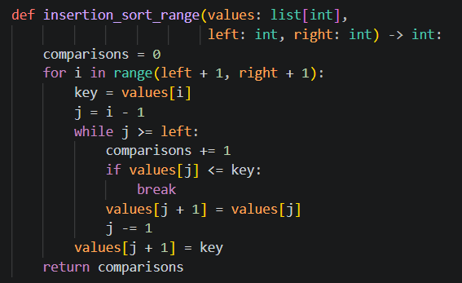
Team 7
Merge Sort
Insertion Sort
Efficiently merges large, sorted subarrays in O(n) time
Efficiently sorts small subarrays
of size S

Slide 6
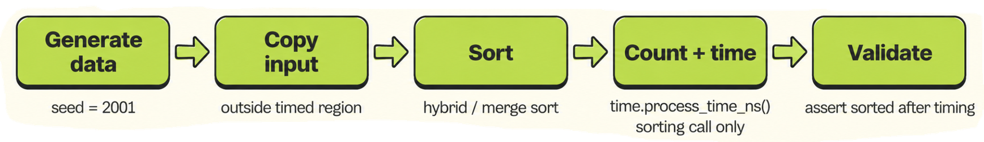
Team 7
Input Generation and Timing Setup
Dataset generation
Timing
  Random seed = 2001
  Values sampled from [1, 10,000,000]
  Input sizes include n = 1,000 up to 10,000,000
  Same unsorted dataset reused within each controlled comparison
  time.process_time_ns()
  Copy input before timing
  Time only the sorting call
  Validate sorted output after timing
  Process CPU time (not clock time)
  Copying & Validation excluded from timing

Slide 7
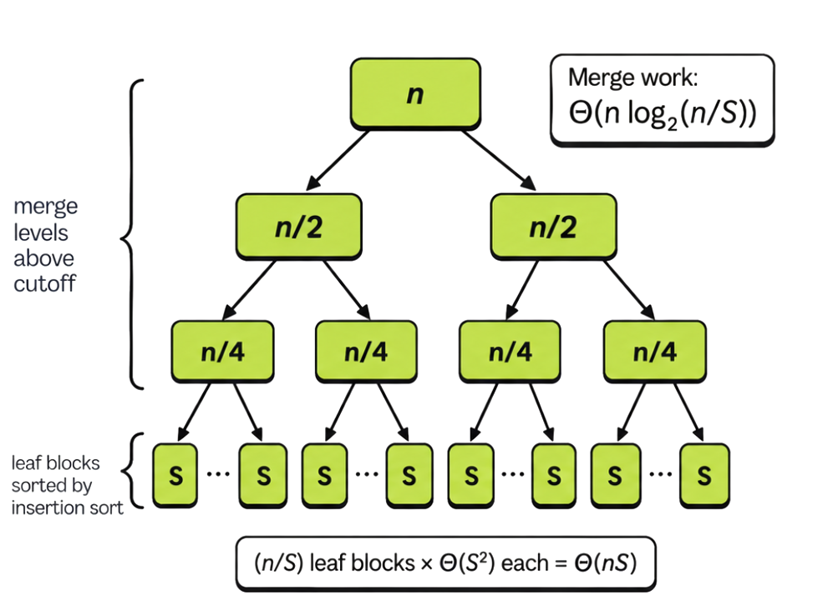
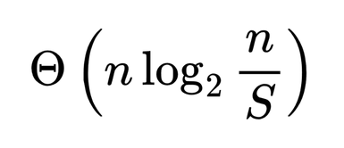
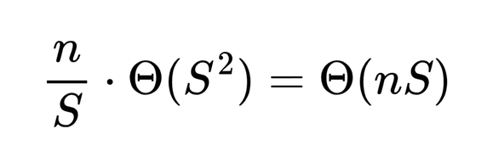
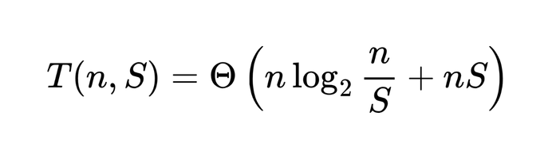
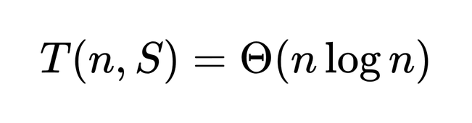
Team 7
Theoretical Model
Merge work above cutoff
Insertion Sort on leaf blocks
Reference model
If S is fixed

Slide 8
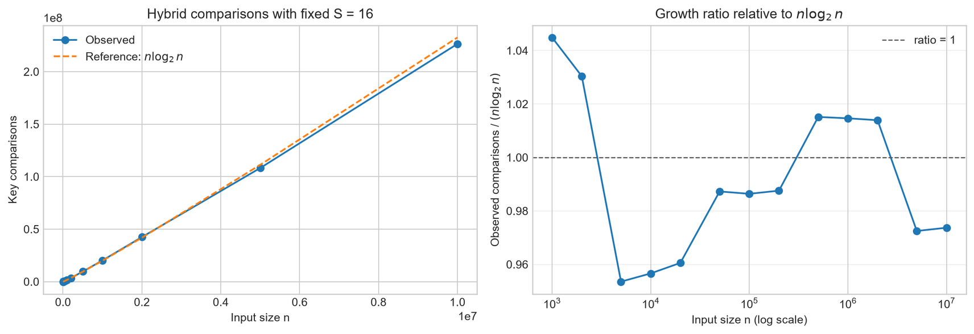
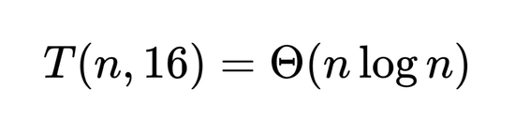

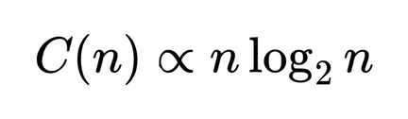

Team 7
C(i): Fixed S, Varying Input Size n
Theoretical expectation
For fixed S, we therefore expect
Empirical observation
  remains roughly 0.95–1.04
  A roughly stable normalized ratio supports proportional growth

Slide 9
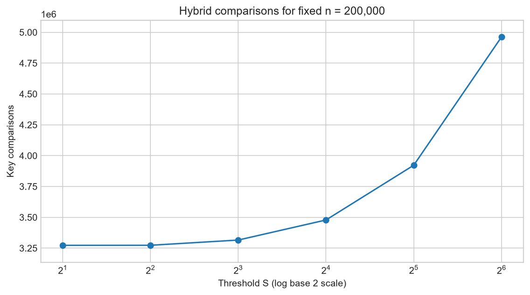
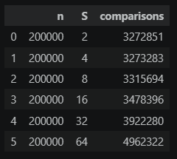
Team 7
C(ii): Fixed n, Varying Threshold S
Results
S=64 performs
~51.6% more
comparisons
than S=2
Interpretation
  Small S → more Merge Sort recursion, but small Insertion Sort leaves
  Large S → fewer recursive levels, but larger Insertion Sort leaves
  As S becomes large, the extra Insertion Sort work dominates the comparison count
For key comparisons alone, the best tested threshold was S=2

Slide 10
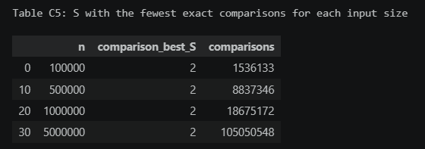
Team 7
C(iii) Setup & Finding a Practical S
A) based on key comparisons
C(iii) experiment
  Input sizes: 100,000; 500,000; 1,000,000; 5,000,000
  Tested S: 2, 4, 8, 12, 16, 20, 24, 32, 48, 64
  5 CPU-time runs per (n, S)
  Median CPU time used for stability and reduce sensitivity to noisy single timing runs
  Least number of comparisons occur at S = 2 because the insertion-sort blocks are kept very small, minimizing its O(S^2) comparison cost
  Comparison count increases as S grows because insertion-sort blocks become larger

Slide 11
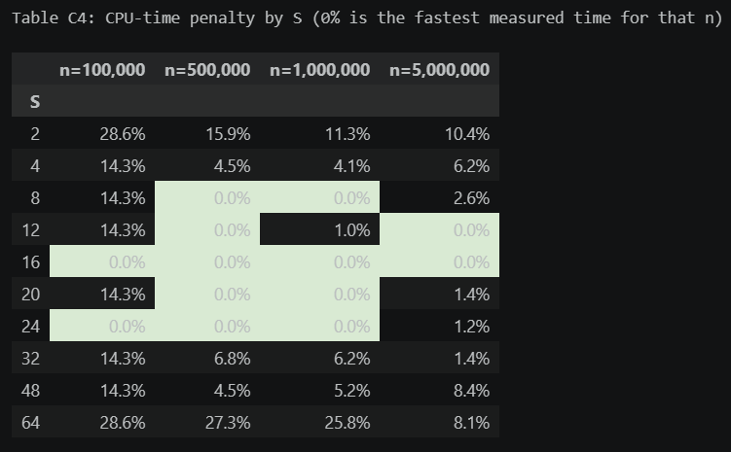
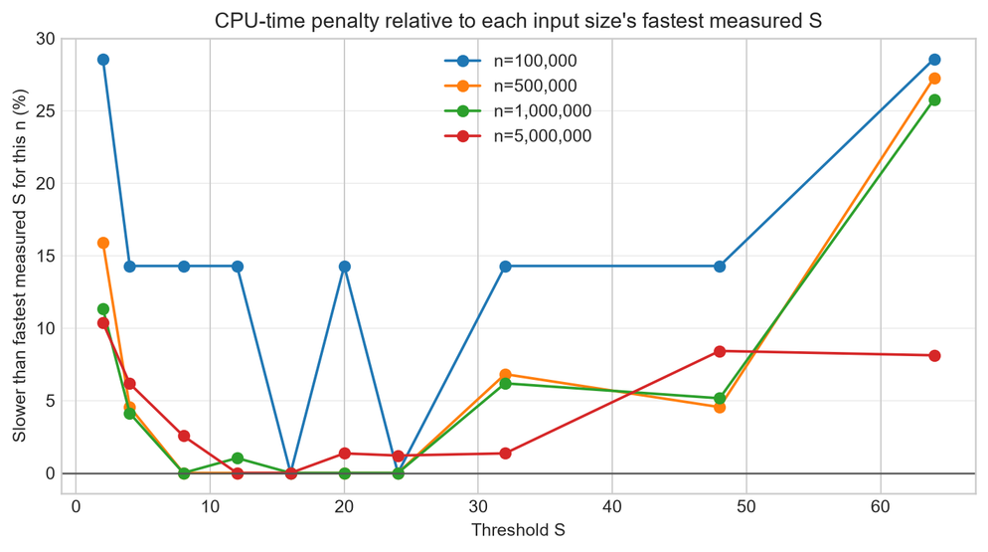
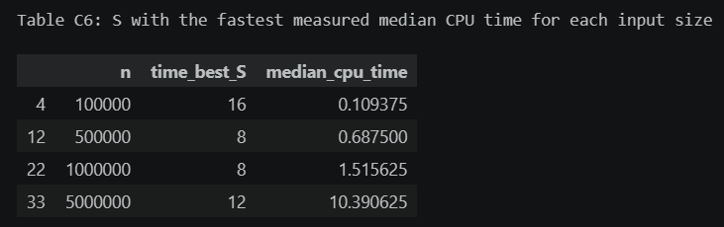
Jacqueline Thompson, 2028
C(iii) Finding the Practical S
B) based on CPU time
How we selected practical threshold S
  For each n, normalize each median runtime by the fastest measured runtime for that n
  Average the relative runtime across all four input sizes
  Select the S with the lowest average

Slide 12
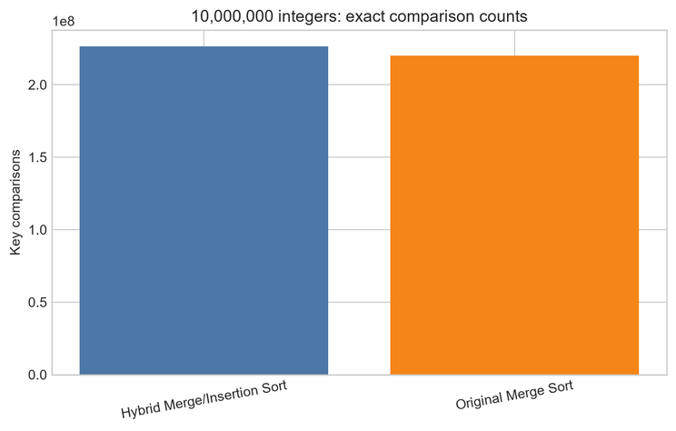
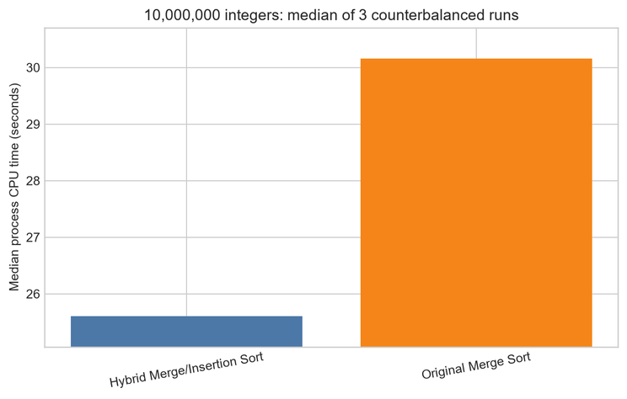
Team 7
Part D: Original Merge vs Hybrid Sort
Part D setup
  n = 10,000,000
  Hybrid threshold: S = 16
  3 timing runs per algorithm
  Counterbalanced order:
    Merge → Hybrid → Hybrid → Merge → Merge → Hybrid
    Done to reduce run-order bias
Key differences
  Hybrid: +2.870% key comparisons
  Hybrid: −15.078% CPU time
  Speedup: 1.178×
More comparisons did not mean slower execution: Hybrid Sort was ~15.1% faster in our experiment
Result
Algorithm | Comparisons | Median CPU Time (sec)
Hybrid Sort | 226415036 | 25.609375
Original Merge Sort | 220098332 | 30.15625

Slide 13
Team 7
Conclusion
  Hybrid Merge/Insertion Sort preserves the expected Θ(nlog⁡n) behaviour when the threshold S is fixed.
  Our experiments also showed the expected trade-off: increasing SS reduces recursive Merge Sort work, but causes Insertion Sort to handle larger subarrays and perform more key comparisons.
  For practical performance, minimum comparisons did not correspond to minimum CPU time. Using results across multiple input sizes, we selected S=16 as the best aggregate measured threshold for our implementation.
  At n=10,000,000, the Hybrid Sort used slightly more comparisons but achieved lower median CPU time than standard Merge Sort.
Overall, the hybrid approach improved practical runtime by reducing recursion and merge overhead on small subarrays, rather than by minimizing the number of comparisons.

Slide 14
Team 7
Thank You

